Slide 1
Software Certification of Safety-Critical Avionic Systems: DO-178C
Abenezer Taye
Oct 16, 2023

Slide 2
Outline
Objective of the Presentation
Historical Perspective of DO-178C
DO-178C Overview
Certification Lifecycle
Example
Conclusion

Slide 3
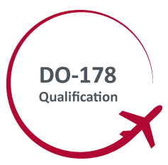
Objective of the presentation
Every avionic software that is potentially related to safety need to undergo the DO-178C certification
The aim of this presentation is:
To be familiar with the standard and become a better aerospace engineer
Understand the DO-178x verification philosophy and use the approach while proposing a new solution to aviation safety related problems → working example

Slide 4
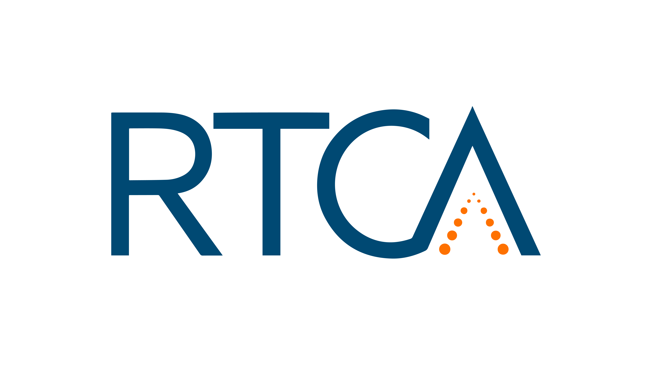

Historical perspective
In 1992 FAA accepted guidelines developed by RTCA (Radio Technical Commission for Aeronautics) → DO-178B
Aim of DO-178B → assure software developed for avionics system is reliable and safe to use in flight
DO-178B was very successful in that:
No hull-loss accident
Only a small number of in-flight upsets

Slide 5
Historical perspective
However, there are some drawbacks of DO178-B:
Key concepts are ambiguous and inflexible
Advancements in modern software development such as:
Model-based development
Formal Methods
OOP, have not been addressed in DO-178B
Dec 2004, RTCA & EUROCAR decided that DO-178B should be updated
They worked on DO-178C March 2005 – Nov 2011 → FAA approved July 2013

Slide 6
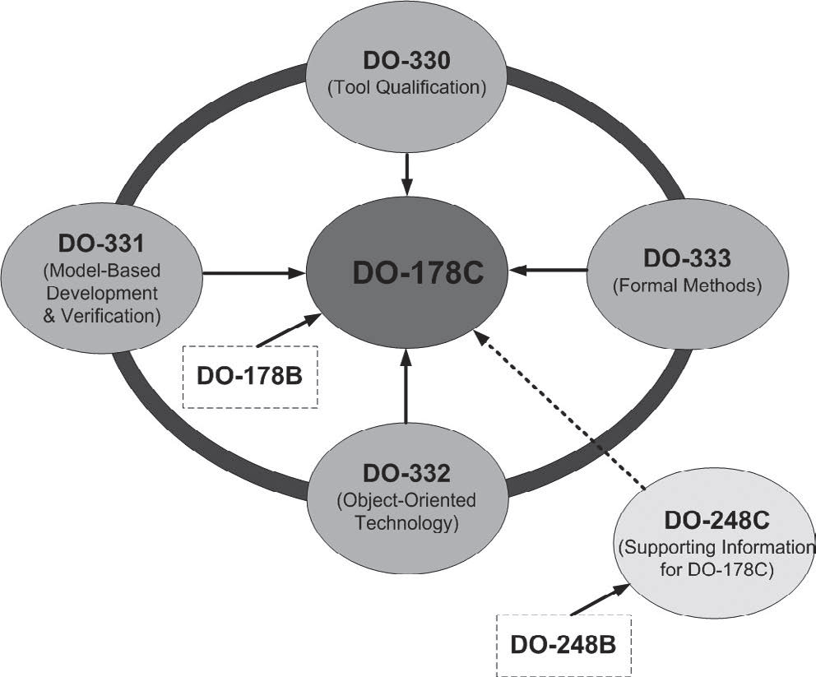
DO-178C and other supplementary documents

Slide 7
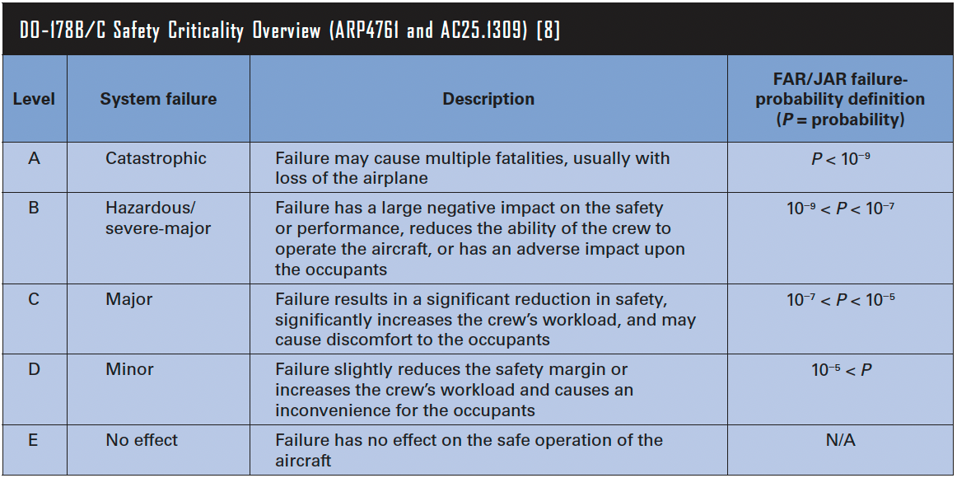
DO-187C overview

Slide 8
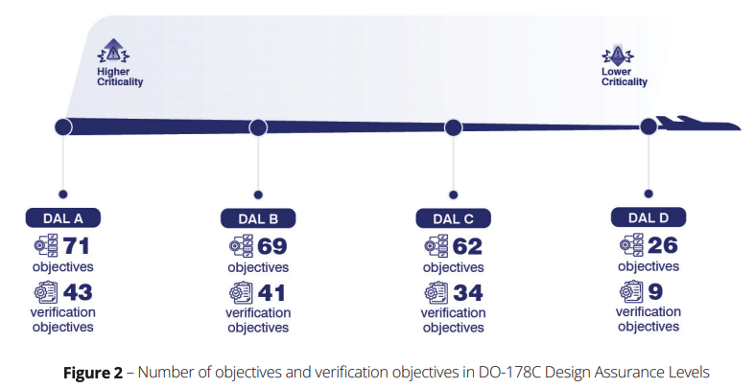
DO-187C overview
Recommendations given in DO-178C fall into two types:
Objectives: process requirements that should be met in order to demonstrate compliance to regulation
Objective DAL A-1: Ensure that the software design is fully compliant with the system-level requirements and architecture, and that there are no design errors or omissions.
Activities: tasks that provide the means of meeting objectives
Example: Ensure that the software has been analyzed and verified using formal methods to mathematically prove its correctness and compliance with high-level requirements.

Slide 9
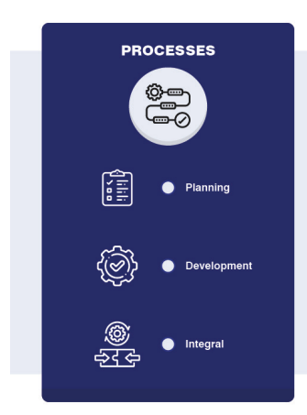
Demonstrating compliance
A specific design assurance process consists of three components:
Planning: the plan will be checked if it meets the required objectives – before you do it
Development: decompose system requirements into software design and implementation
Integral processes (Verification, Configuration Management, QA, Certification Liaison): ensures the above two processes meet their requirements and are well managed
The Certification Liaison activities focus on ensuring that there are sufficient data and checkpoints for the certification authorities to be able to determine compliance and approve the software.

Slide 10
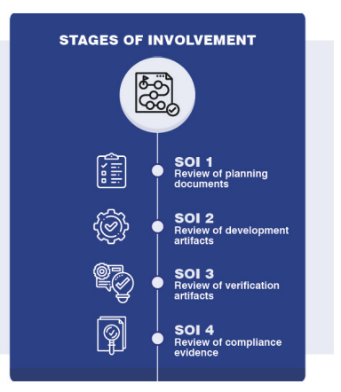
Demonstrating compliance
The typical process for the certification authority to determine compliance is based on four Stage Of Involvement (SOI) reviews:
SOI#1 or Planning Review
SOI#2 or Development Review
SOI#3 or Verification Review
SOI#4 or Certification Review

Slide 11
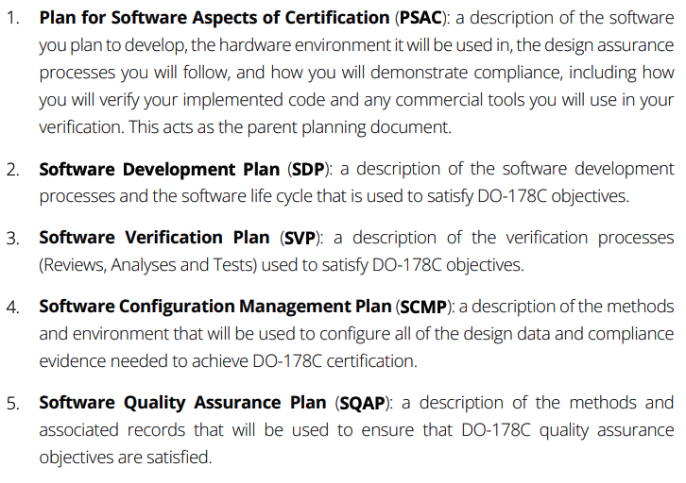
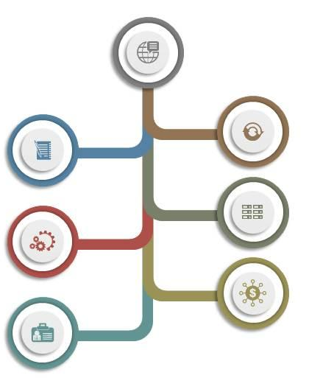
Planning

Slide 12
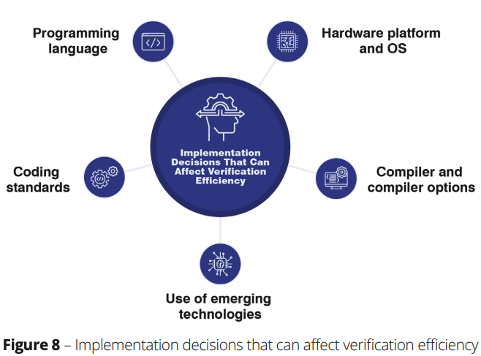
Development
High-level requirements: define system level requirements
Design: design the architecture of your software and define its low-level requirements
Implementation: implementing the code (5% or less effort)
Things you may want to consider:
Choice of programming language(s)
Choice of coding standard
Choice of hardware platform and operating system
Use of emerging technologies such as GPUs

Slide 13
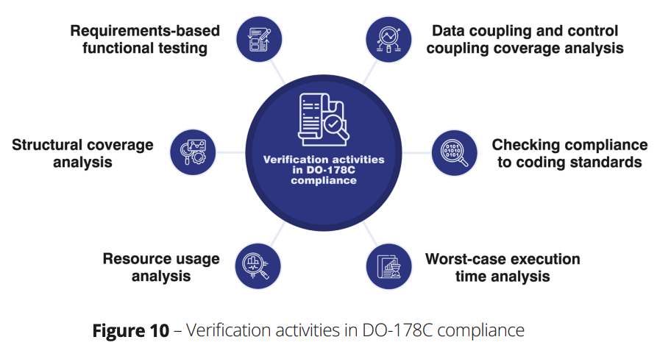
Verification
The number of verification objectives you must meet depends on the DAL level of your software:
For DAL A systems, 43 of the 71 applicable objectives relate to verification
For DAL B systems, 41 of the 69 applicable objectives relate to verification
For DAL C systems, 34 of the 62 applicable objectives relate to verification
For DAL D systems, 9 of the 26 applicable objectives relate to verification

Slide 14
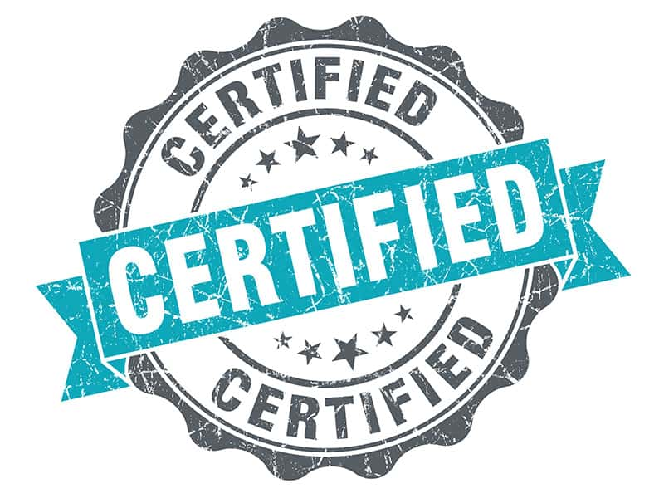
Certification
Done by the certification authority
Looks back at each of the previous SOI reviews and ensures that all observations and findings have been resolved – to the satisfaction of the certification authority

Slide 15
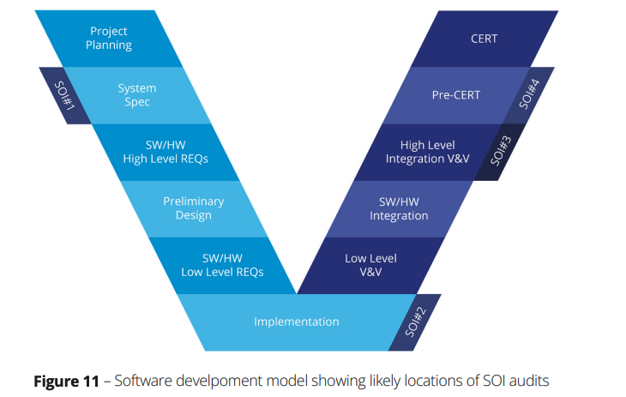
DO-178C Lifecycle

Slide 16
Example: DO-178C certification for PID based autopilot
Planning phase:
Purpose and Requirements: the software controls the aircraft’s altitude to maintain it at a specific level
Verification Procedure: the software will be verified using formal methods-based verification tools and will be tested both on hardware and software.
Development phase:
Requirement development: the software controls the aircraft’s altitude to maintain it at a specific level
Design: the software will have a class that implements all the autopilot related methods
Coding:
Programming language: MATLAB
Coding standard: MISRA

Slide 17
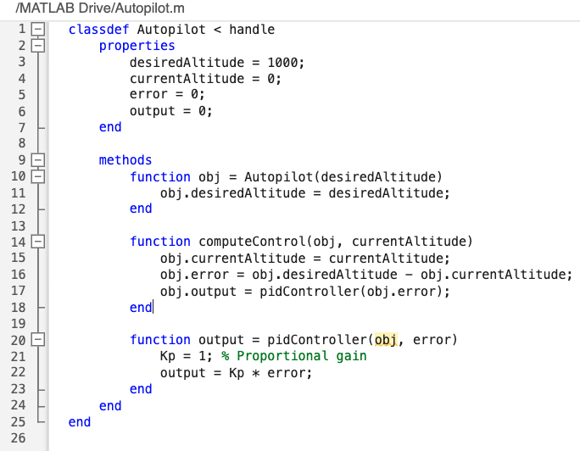
Example: DO-178C certification for PID based autopilot
Verification phase:
Reviews: review reqs, design, and code to ensure they satisfy the plan.
Testing: develop and execute tests to verify that the software meets its requirements
Certification phase:
Configuration management: ensure that all artifact (reqs, design, code, tests) are under configuration management
Quality assurance: ensure that all processes are being followed and objectives are met
Certification Liaison: ensure that all certification-related activities are conducted

Slide 18
Conclusion
Most of the DO-178C work is related to project management and documentation
Organization and technical writing skills are very important
There are some tools that automates most of the DO-178C related tasks
Things you can start now:
Adopt a requirement and test-driven programming approach
Familiarize with coding standards
Pay attention to code quality
Lessons for avionic software related research:
Traceability/explainability is very important for certification - from high-level req → each line of code → each test case
Determinism is also a key feature in certification: you should be able to predict what type of output will come out for a given input

